Slide 1
Chapter 23 – Ecology

Slide 2
23.1 The Physical Environment
You should be able to:
■ distinguish between physical and biotic factors, environment and habitat, population and community;
■ discuss the importance of the physical environment to living organisms.

Slide 3
23.1 The Physical Environment
The Physical Environment
Species – group of organisms with similar physical appearance, behaviour and genes; they can interbreed to produce fertile offspring
Population – group of organisms of the same species living in a particular place at the same time.
Community – different populations made up of different species found in a particular place at the same time.
Habitat – place where an organism lives.

Slide 4
23.1 The Physical Environment
The Physical Environment
The habitat of an organism is made up of living and non-living components.
The living part: the biotic environment and consists of all the other living things that an organism interacts with.
The nonliving part: the abiotic environment and consists of physical factors such as light, water, pH and nutrients of the soil and water.
Both environments determine the types of organisms and the kind of relationship that is formed between organisms.
The abiotic factors can be divided into three main factors which are soil, water and climate.

Slide 5
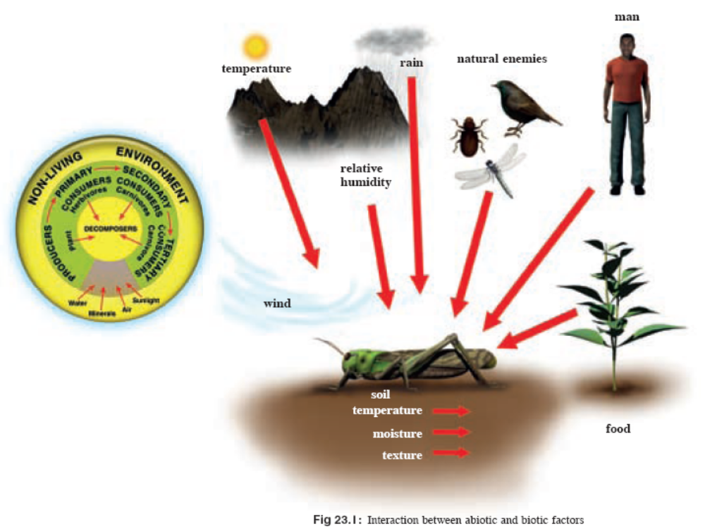
23.1 The Physical Environment

Slide 6
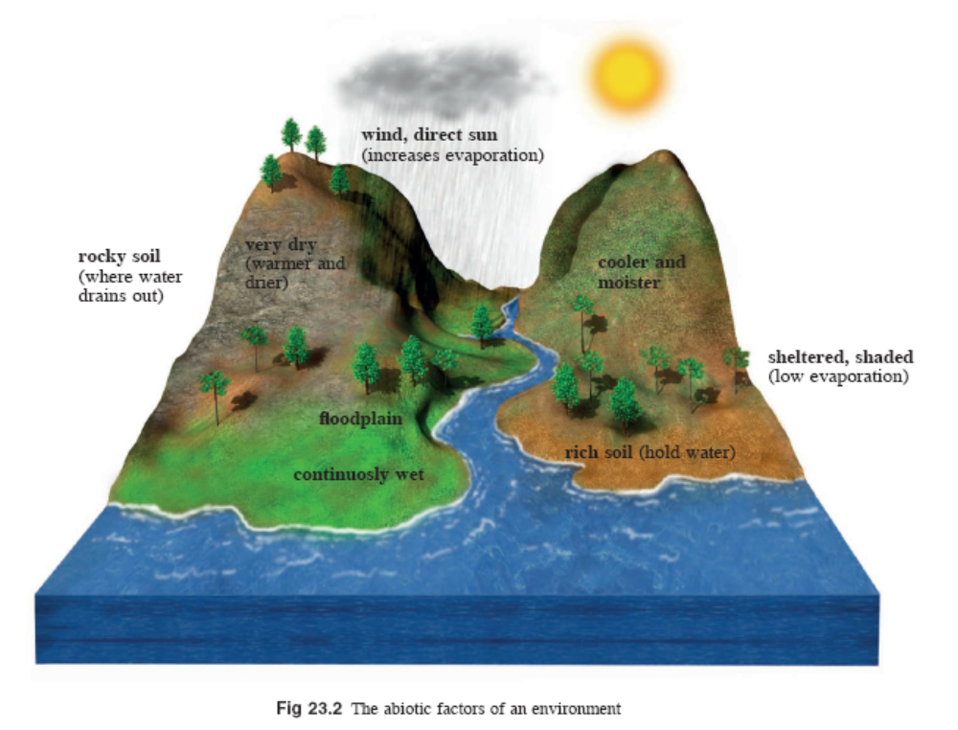
23.1 The Physical Environment

Slide 7
23.1 The Physical Environment
The Physical Environment
Oxygen content, salinity, pH and nutrient content in the
soil and water affect organisms living in these environments.
Oxygen and nutrients are required by organisms for respiration, growth and development.
Extreme changes in salinity and pH affect cells of organisms. Some aquatic animals and plants have special adaptations to survive in saltwater or freshwater environments.
Plants and other organisms living in the soil are affected by soil texture, porosity, permeability, water-retaining capacity and oxygen content.

Slide 8
23.1 The Physical Environment
The Physical Environment
Climate determines the amount of light, water, wind and
temperature of the environment.
• Light intensity affects the distribution and growth of both plants and animals. Depending on their needs, plants and animals adapt specially to obtain maximum amount of light or block off excessive light. Some animals adapt to places where no light is available.
• Temperature affects chemical reactions in cells which are important for functioning of body processes and metabolic activities.

Slide 9
23.1 The Physical Environment
The Physical Environment
• Water is important for life in all living organisms. Where water is insufficient, plants and animals can adapt themselves to prevent excessive loss of water or store large amounts of water in their bodies. Aquatic plants and animals can also adapt to life in the water.

Slide 10
23.2 An Ecological Study
You should be able to:
■ conduct an ecological study using appropriate sampling methods.

Slide 11
23.2 An Ecological Study
An Ecological Study
An ecological study can provide useful information of a
particular habitat. (Only small sample of habitat is studied.)
The objectives of an ecological study are:
• to find out which species are present at the site;
• to analyse the distribution of species at the site and their relative abundance;
• to monitor population changes of the different species at the site; and
• to assess effectiveness of the management of the site.

Slide 12
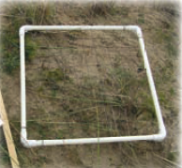
23.2 An Ecological Study
Random Sampling Using Frame Quadrats
A quadrat is a square frame usually of either 0.5 m × 0.5 m or 1.0 m × 1.0 m.
The quadrat can be divided by string or wire into equal subdivisions. It is laid on the ground; and whatever that is inside the quadrat is identified and recorded.

Slide 13
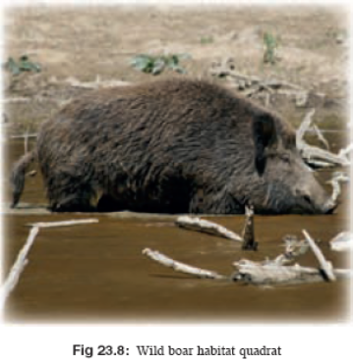
23.2 An Ecological Study
Random Sampling Using Frame Quadrats
A quadrat can be placed in two ways:
Random:
• The whole site is divided into squares on a grid and points are selected using random numbers generated by a computer, a table or special calculators
• One can stand in the centre of a site and throw the quadrat in various directions and survey the area it lands on.
Transect:
• An imaginary line is drawn across the site
and the quadrat is placed at regular intervals
along the line.

Slide 14
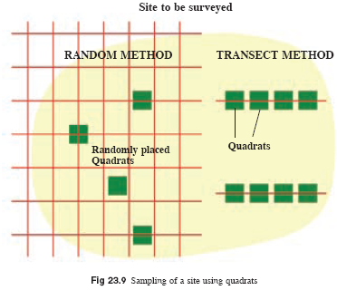
23.2 An Ecological Study

Slide 15
23.2 An Ecological Study
Random Sampling Using Frame Quadrats
The abundance of an organism can be measured in a number of ways, depending on its size and the habitat.
It is important that many quadrats are used so that a large sample size is obtained to ensure reliable results.
The larger the sample size, the more representative are the results of the whole area.

Slide 16
23.2 An Ecological Study
Random Sampling Using Frame Quadrats
Here are some ways of measuring abundance:
• Density of a species – count the number of times a particular species occurs within all the quadrats and then calculate the average number per unit area.
• Frequency of occurrence – count the number of times a species occurs in a quadrat. E.g. if a species is found in 10 out of 40 quadrates, the frequency of occurrence is 25%.
• Percentage cover – estimate the area that the species covers within a quadrat.
• Abundance scales – specific scales that measure abundance. E.g. ‘DAFOR ’ scale (Dominant, Abundant, Frequent, Occasional, Rare)

Slide 17
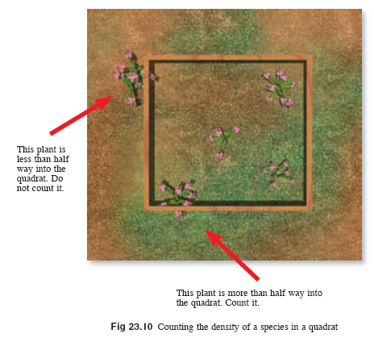
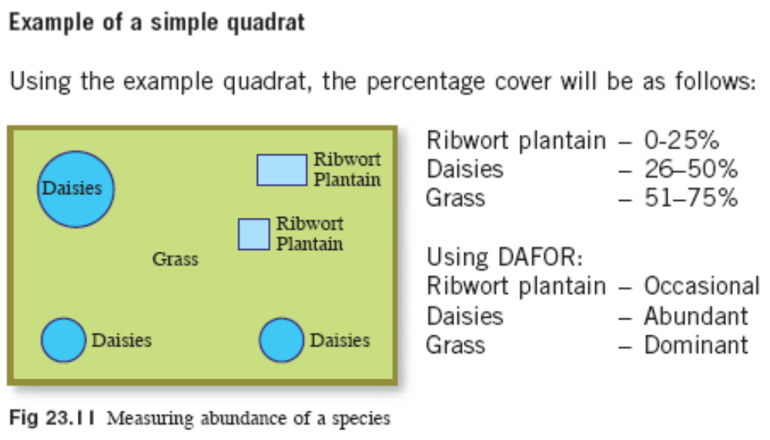
23.2 An Ecological Study

Slide 18
23.2 An Ecological Study
Random Sampling Using Frame Quadrats
Another way of surveying an area is to use nets or pitfall
traps.
Sweep netting – Sweep an area with a net for a certain time while one is walking along a transect. Everything caught in the net is identified.
Pitfall traps – Set up traps at equal distances along a transect by placing bottles or jars into the ground, making sure that the top of the container is at the ground level. The container may be covered to keep out the rain or predators. Any insects or small animals that fall into the container are identified.

Slide 19
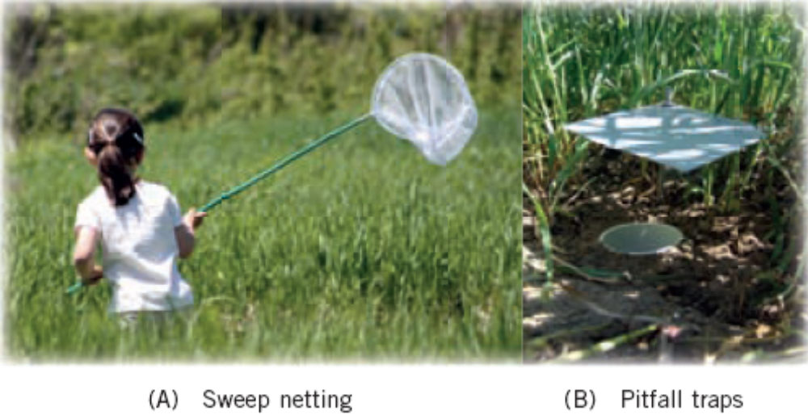
23.2 An Ecological Study

Slide 20
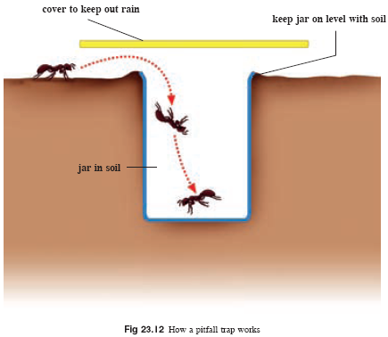
23.2 An Ecological Study

Slide 21
Key Concepts
A species is a group of organisms, with similar physical appearance, behaviour and genes; they can mate with one another to produce fertile offspring.
A population is a group of organisms of the same species living in a particular place at the same time.
A community refers to all the different populations found in a particular place at the same time.
The place where an organism lives is called the habitat and is made up of living and nonliving components.

Slide 22
Key Concepts
The biotic environment consists of all the other living things that an organism interacts with. The abiotic environment consists of physical and chemical factors.
The abiotic factors can be divided into three main factors which are soil, water and climate.
The oxygen content, salinity, pH and nutrient content in the soil and water affect the organisms that live in these environments.
The climate determines the amount of light, water, wind and temperature of the environment.

Slide 23
Key Concepts
An ecological study can provide useful information of a particular habitat, such as the type of species present, the distribution of species and their relative abundance.
Different groups of species require different techniques to measure the abundance and distribution of species in a particular area.
Surveying a particular area can be done randomly or along a transect using quadrats, sweep-netting or setting pitfall traps. A large number of samples are taken to ensure reliable results.

